Slide 1

US WIND TURBINE MARKET
Billy Bingham, Anastasiya Khanevich, Daniel Zhang, Vicky Summerson

Slide 2
Recommendations:
Most efficient operator (produces highest amount of energy with fewer turbines): | MidAmerican Energy Company ($894 million 2022, net profit margin 92%)
Top wind operator by median electricity rates ($/MWh), wind speed (30km/h) and electricity generated: | Nextera (high electricity rates, net profit $4.15 billion in 2022), MidAmerican Energy Company (predominantly located in Iowa with strong wind speeds)
Most number of wind power projects in US: | General Electric (364), Vestas (197)
Minimum maintenance for manufacturer based on % of refits to turbines ratio: | Vestas
Notes:
MidAmerican Energy Company most efficient (generates more electricity with fewer turbines so may have less running costs as there are less turbines to manage)
Nextera has highest electricity rates so may generate good profits, MidAmerican Energy Company has the highest wind speeds and electricity generated (good low risk company to invest in), Vestas may have less maintenance costs

Slide 3
Assumptions
Null values for columns: units online, units under construction, capacity online and capacity under construction were imputed with o as adding these columns together equalled to the totals column, therefore the blank cells had to be 0
Operators that fell under the same umbrella company that were different entities were changed to the name of the parent umbrella company to show the true figures for the umbrella company
We felt capacity was more important than the number of turbines owned and therefore decided not to include a figure showing the total number of turbines owned by operators, as the top 3 operators were the same for the highest number of turbines, and the largest capacity.
We looked at the wind turbine industry from its beginning in 1981, however we also focused on the last 10 years as wind technology has progressed significantly during this time and we therefore felt this time period should be looked at separately
Notes:
Before diving into our findings, I will first explain the assumptions we had during our data cleaning

Slide 4
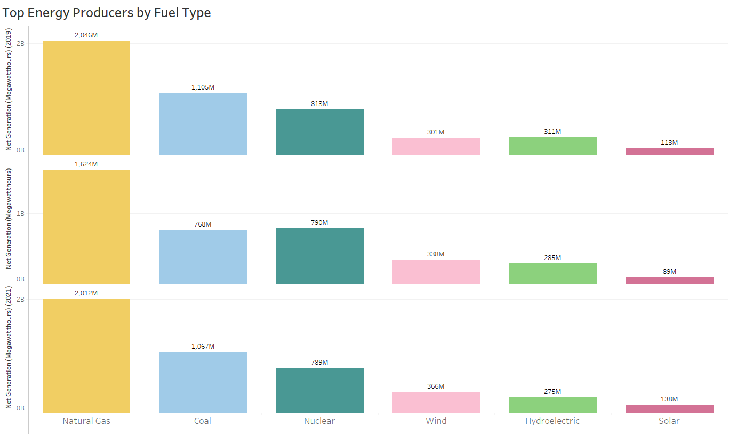
The US wind industry saw a 12% increase from 2019-2020 and an 8% increase from 2020-2021
The US wind power market has seen significant growth in recent years. In 2020, the country installed over 16 GW of new wind capacity, which was a record high.
According to the American Wind Energy Association, in 2020, the US had a total installed wind capacity of over 118 GW, which generated more than 7% of the country's electricity
Notes:
Is the wind turbine market a good market to invest in? We can see that the US wind industry saw a 12% increase in net energy generation from 2019-2020 and an 8% increase from 2020-2021, it also currently generates more energy than other renewables such as hydro and solar.
The US wind energy market is a good market to invest in

Slide 5
NextEra Energy Resources, LLC | solar, natural gas, nuclear power assets, battery storage
AVANGRID | natural gas, solar, wind, battery storage facilities
MidAmerican Energy Company | Wind, natural gas, coal, solar
RWE Renewables Americas, LLC | wind, solar, battery storage, hydroelectric
Enel Green Power North America Inc. | wind, solar, geothermal, hydroelectric, energy storage
Invenergy | wind, solar, energy storage, natural gas,
EDP Renewables | Wind and solar, energy storage
Clearway Energy Group | wind, solar, energy storage, natural gas
EDF Renewables | wind, solar power, hydroelectric, geothermal and biomass
AES Clean Energy | solar, energy storage, wind, bioenergy
WHICH OTHER TYPES OF POWER THE WIND OWNERS ALREADY OWN
Notes:
Wind turbine operators also own other types of power that allows them to be quite diversified. Many of the key players such as Nextera, Avangrid, Invenergy and EDP are also investing in power storage to help integrate renewable energy into the grid more effectively so these would be particularly good companies to invest in

Slide 6
Number of Turbines in 2009
21,177
Wind Power is a fast growing industry. In the early day of wind power (1981 - 2009), there was a total of just over 21,000 turbines located across the US. Since then, the total number of turbines in the US has risen to over 71,000 - an increase of 236% since 2009.
If we drill down to specific states from the number of turbines pre-2009 compared to today, there has been very large growth in certain areas - mainly around the Midwest region:
Number of Turbines in 2022
71,287
State | Turbines 1981 - 2009 | Total Turbines 1981 - 2022 | % increase from 2010 - 2022
Nebraska | 63 | 1401 | 2123%
Oklahoma | 584 | 5044 | 763%
Kansas | 631 | 3930 | 522%
Texas | 5505 | 17521 | 218%
Iowa | 1960 | 5551 | 183%
In 13 years, the number of wind turbines in the US has grown by:
236%

Slide 7
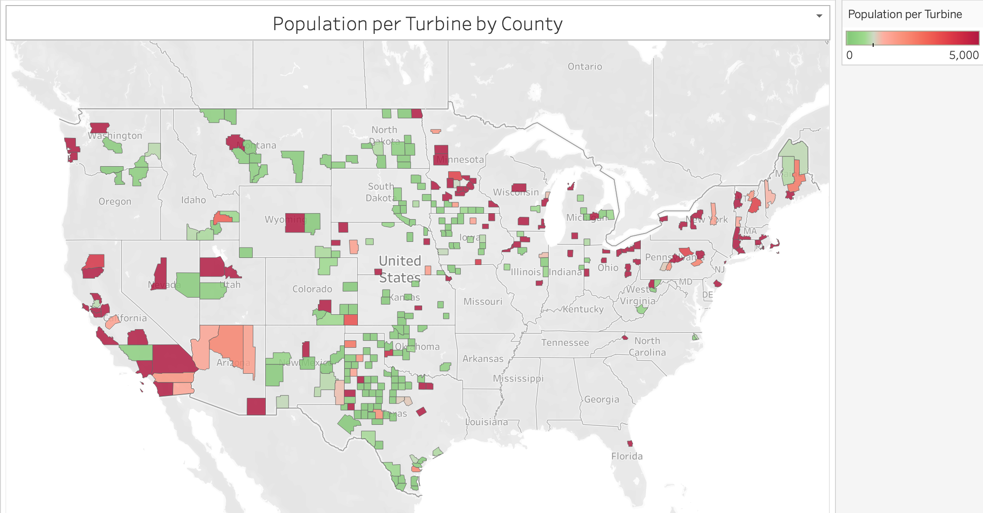
In the state of Iowa, we can see there are areas of large populations, surrounding rural areas with high numbers of turbines. This is important as it shows there is potential for high growth, whilst also effectively being able to serve large populations.
Notes:
Look for less populated areas as more space for turbines

Slide 8
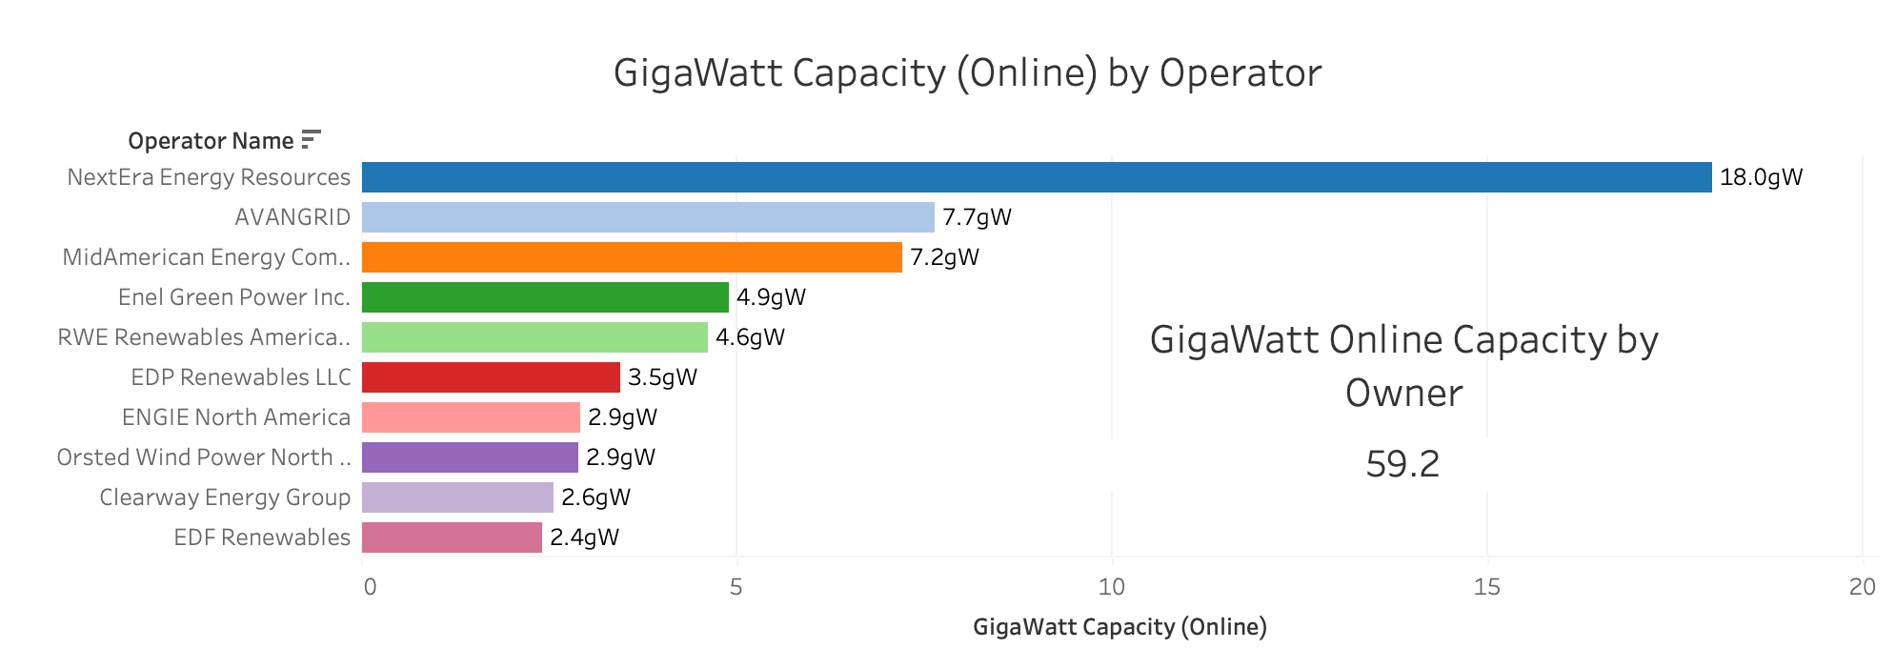
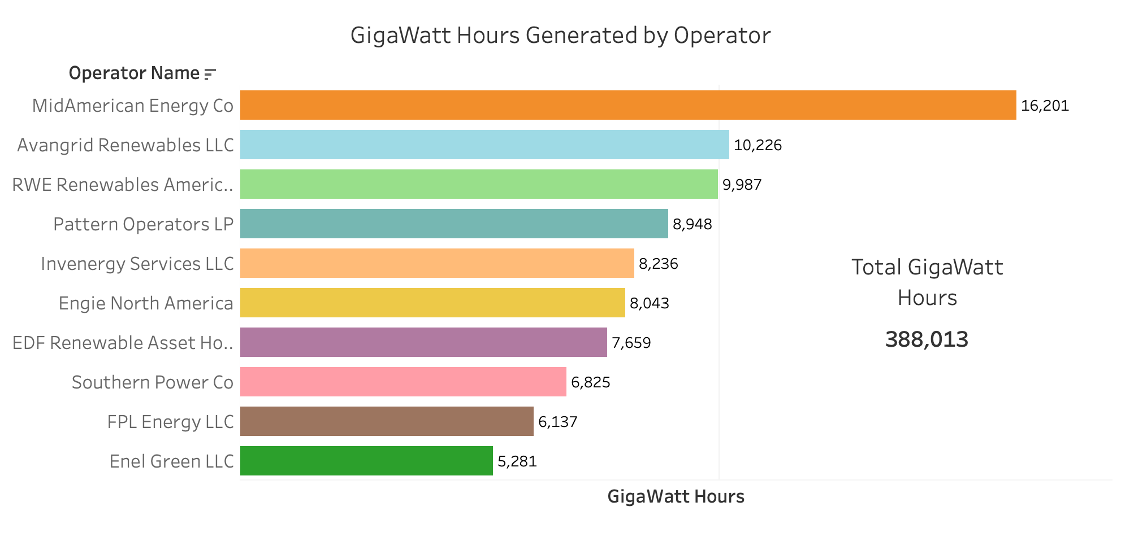
Here we can see NextEra Energy has the highest online capacity, representing a 30% market share of capacity, whilst MidAmerican Energy have the third highest capacity representing a 12.2% market share. This is important to note when we look at GigaWatt Hours generated by owner below.
Total GigaWatt Capacity
59.2gW
Despite only having the third largest market share with regards to capacity, MidAmerican Energy generates the highest level of GigaWatt Hours compared to any of its competitors.
This shows a high efficiency of its turbines.
Also, over 50% of MidAmerican Energy turbines are located in Iowa, which as we have already seen is a good location for turbines due to the balance of urban and rural areas.

Slide 9
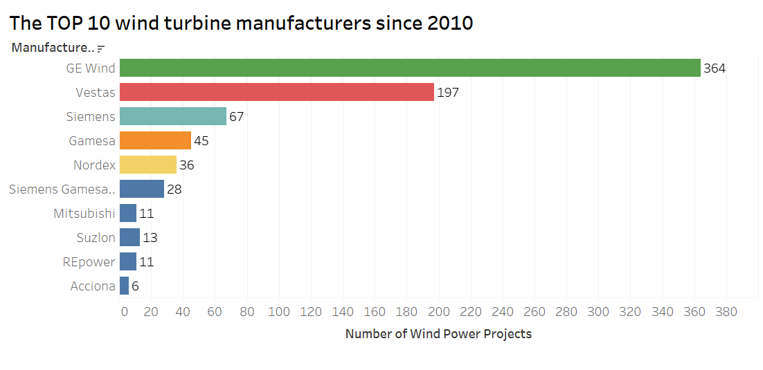
General Electric Wind - ~ 44% of market share.
Vestas - second significant presence in the USA.
Siemens and Gamesa merged as Siemens Gamesa in 2017. As a result, a global presence and a diverse portfolio.
Nordex’s turbines are designed for low-wind conditions.

Slide 10
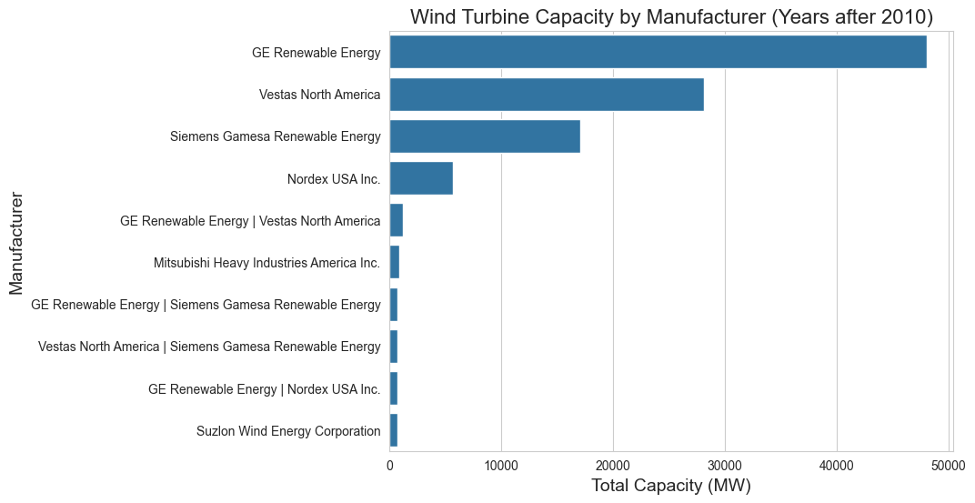

Slide 11
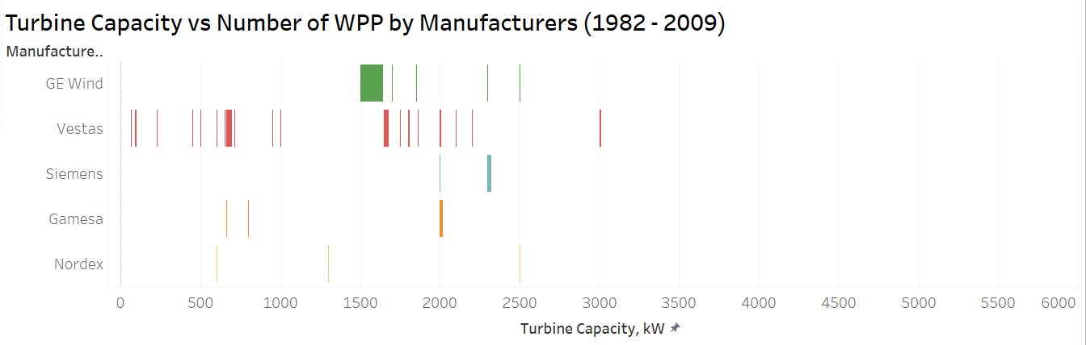
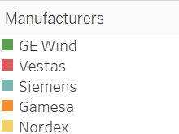
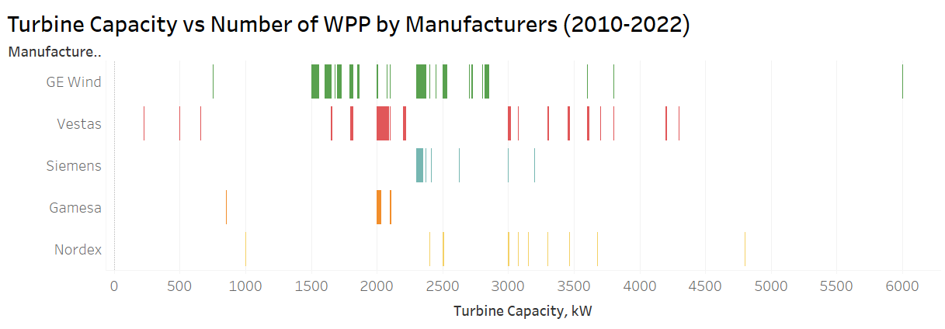
A range of turbine capacity has expanded significantly since 2010

Slide 12
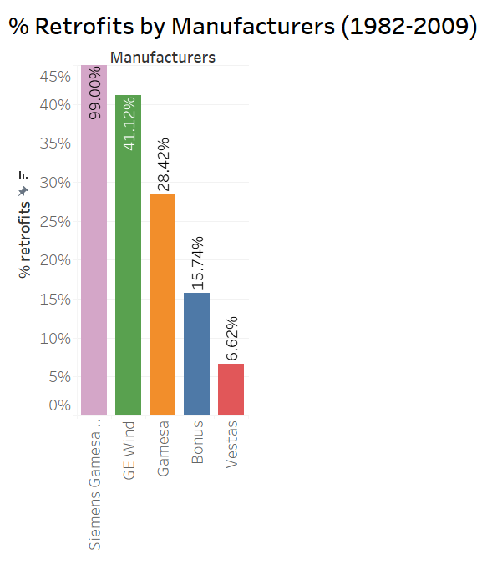
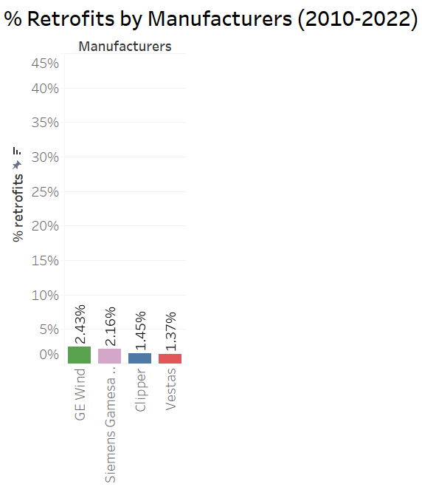
Reasons of retrofits:
replacing outdated components
improving the efficiency of the turbine
extending its lifespan

Slide 13
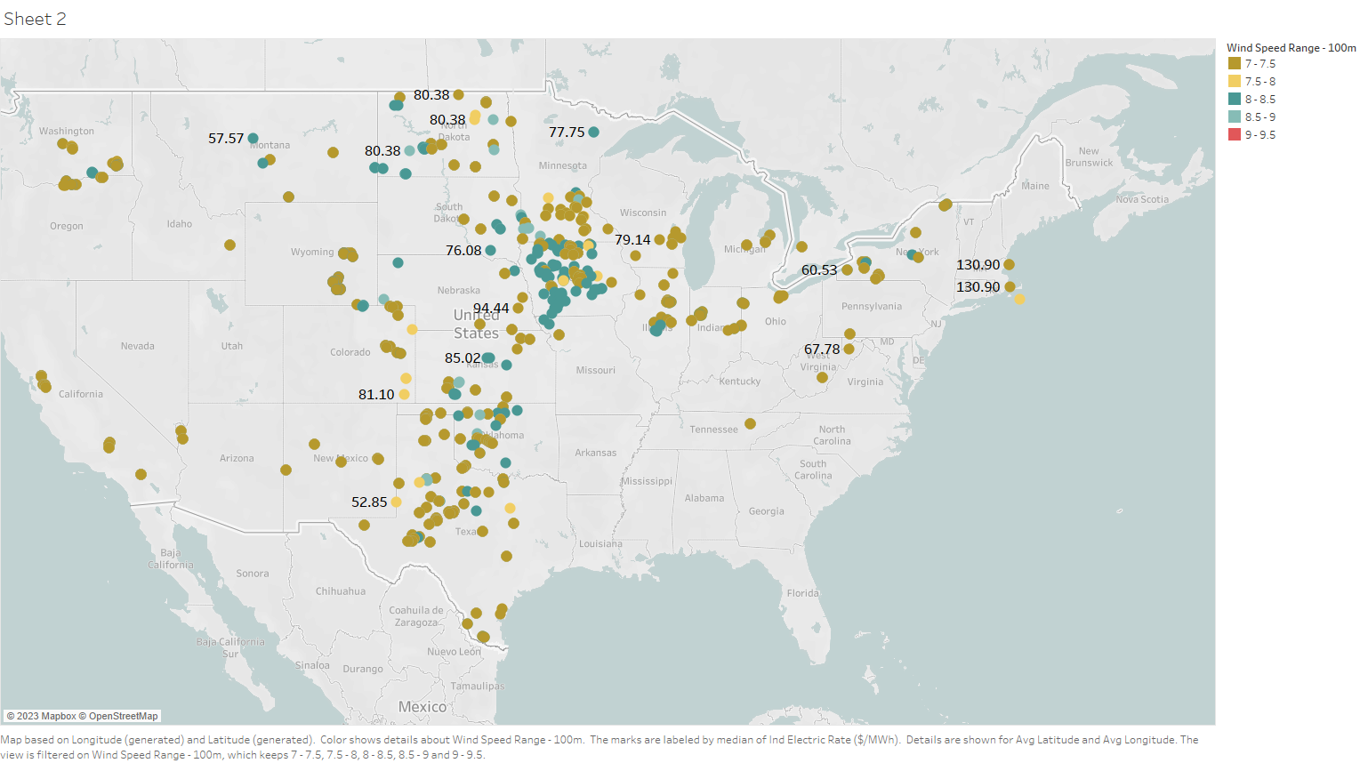
Top Wind Speed Range (30km/h) and Electricity Rate ($/MWh) By US States

Slide 14
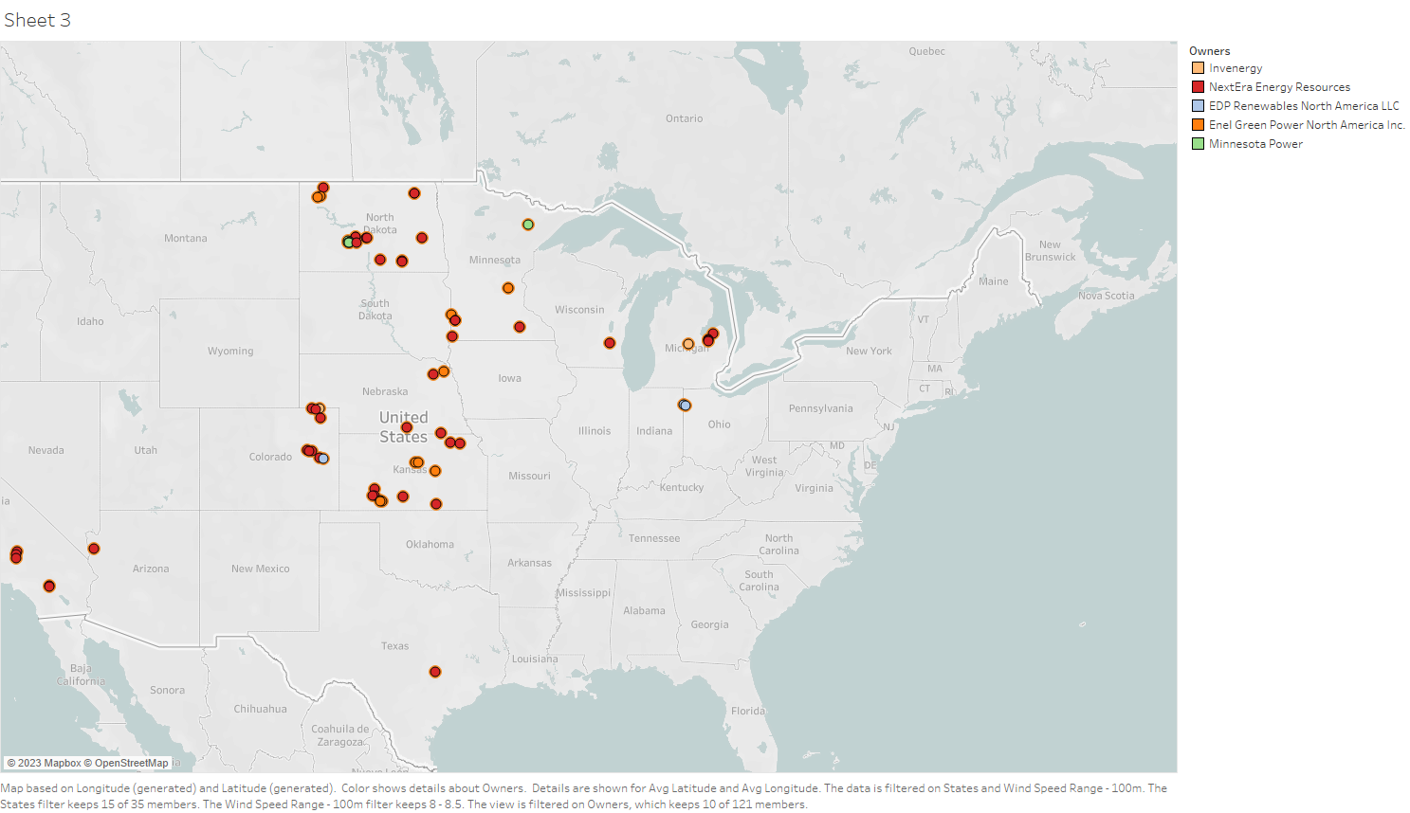
Top 5 Wind Operators by Median Electricity Rates ($/MWh), Wind Speed (30km/h) and Capacity

Slide 15
Risks associated with investing in the wind industry in the USA:
Regulatory risk: Changes in government policies or regulations
Technological risk: Wind turbines may not perform as expected, or that new and better technology may make current investments obsolete
Market risk: Fluctuations in energy prices and demand
Environmental risk: Wind turbines can have negative impacts on local wildlife and habitats, and there may be opposition to new projects from environmental groups or local communities
Financing risk: the cost of financing could increase, making projects less profitable

Slide 16
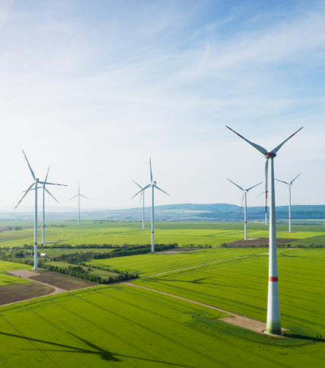
Thank you
for your attention!

